Slide 1
Advocates’ Briefing on Inclusionary Zoning
How IZ Fits into DC’s
Affordable Housing Toolbox
Claire Zippel
October 22, 2015

Slide 2
Steps in the Right Direction
Growing awareness of our affordable housing crisis
Highest level of local funding for affordable housing in city’s history: $223 million for FY16
Sale of city-owned land is creating affordable housing across city
But need still outpaces budget

Slide 3
Inclusionary Zoning Harnesses A Hot Housing Market
Uses no budgetary resources
Bonus density helps compensate for below-market rents
Most IZ production has been in Wards where subsidy cost of building affordable housing is highest in city
Source: Average subsidy cost per unit by Ward, Urban Institute Housing Affordable Needs Assessments Phase II, 2015. Graphic: DC Office of Planning preliminary set-down report for case no. 04-33G

Slide 4
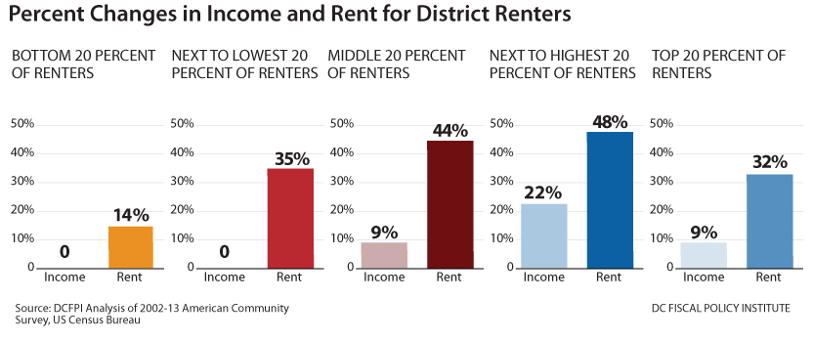
Average Rent Growing Faster than Average Incomes for Low-Income Households

Slide 5
Affordability Problems Most Serious Among Low-Income Rental Households
Severe Rent Burden on the Rise
 | % Of Households Burdened
AMI | 2002 | 2013
<30% | 50% | 64%*
30%-50% | 8% | 31%*
50%-80% | 1% | 10%*
80%-100% | 0% | 1%
100%-120% | 0% | 0%
120%+ | 0% | 0%
Source: DCFPI analysis of 2002-2012 American Community Survey 1-Year Household Estimates. All figures adjust for inflation. * indicates a statistically significant change in share of households burdened.
Incomes as a Percent of the Area Median
Household Size | 80% | 50%
1 | $61,200 | $38,200
2 | $69,900 | $43,700
3 | $78,600 | $49,100
4 | $87,400 | $54,600
Source: DHCD IZ Income Limits and Price Schedule, 2015.

Slide 6
Most IZ Units Aren’t Affordable to Low-Income Households
Most IZ Rental Units Out of Reach for Low-Income Households
Income level | Percent of IZ units | Maximum Income for two-person household | Example household | IZ rent for one-bedroom
50% AMI | 12% | $43,700 | A security guard and part-time childcare worker A bus driver with one child | $1,000
80% AMI | 88% | $69,900 | A medical assistant and part-time computer user-support specialist A reporter with one child | $1,600
Source: IZ production as of 2015 courtesy of DHCD;. DHCD 2015 IZ Income Limits and Price Schedule. US Department of Labor, Bureau of Labor Statistics, State Occupational Employment and Wage Estimates, 2014.

Slide 7
DC Zoning Commission Will Consider Making IZ Units More Affordable
Under Proposal, IZ Rental Units Will Be More Affordable
Income level | Percent of IZ units | Maximum Income for two-person household | Example household | IZ rent for one-bedroom
50% AMI | Currently: 12% | $43,700 | A security guard and part-time childcare worker A bus driver with one child | $1,000
60% AMI | Proposed: All IZ rentals | $52,400 | A delivery truck driver and part-time receptionist A mail clerk with one child | $1,100
80% AMI | Currently: 88% Proposed: All IZ condos | $69,900 | A medical assistant and part-time computer user-support specialist A reporter with one child | $1,600
Source: IZ production as of 2015 courtesy of DHCD. DHCD 2015 IZ Income Limits and Price Schedule. 60% MFI calculations follow DC Code § 42–2801. US Department of Labor, Bureau of Labor Statistics, State Occupational Employment and Wage Estimates, 2014.

Slide 8
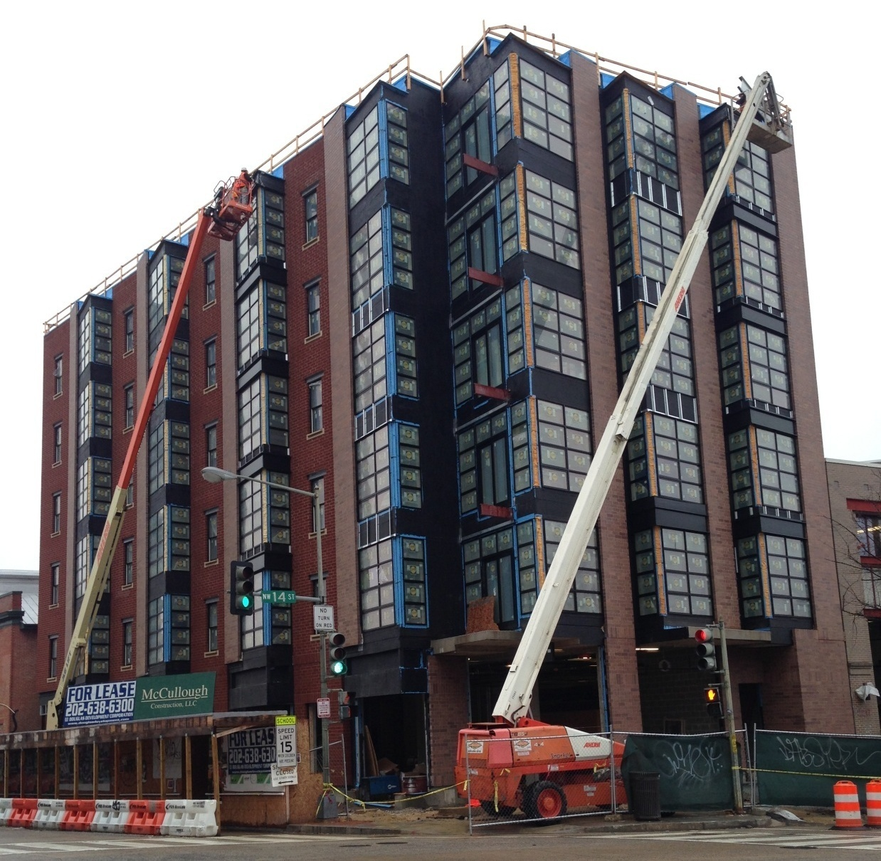
Strengthening District of Columbia’s
Inclusionary Zoning
Campaign for
Inclusionary Zoning
Advocates’ Briefing
By Cheryl Cort,
Coalition for Smarter Growth
October 22, 2015
2221 14th St, NW, 30-unit building with 4 IZ units under construction near the U Street Metro station (photo by author)
Notes:
Source: DC Office of Planning

Slide 9
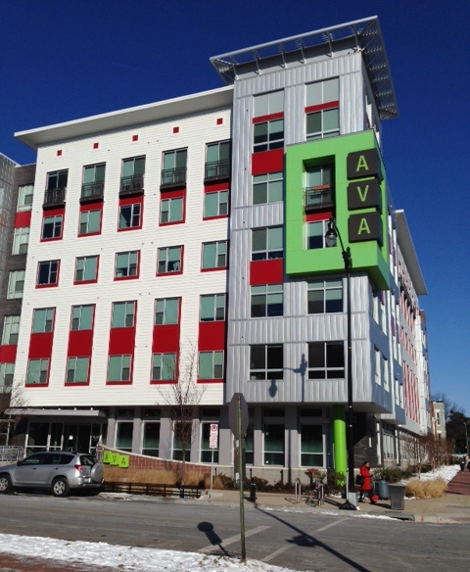
What is DC Inclusionary Zoning?
Inclusionary Zoning (IZ) is a law that requires that permanently affordable residential units (Inclusionary Units) be set aside in either a new development or a substantial rehabilitation in exchange for a bonus density.
Created by the DC Zoning Commission in 2006
Administered by the DC Department of Housing & Community Development
Ava H Street, 318 I Street, NE, 14 IZ units (photo by author)

Slide 10
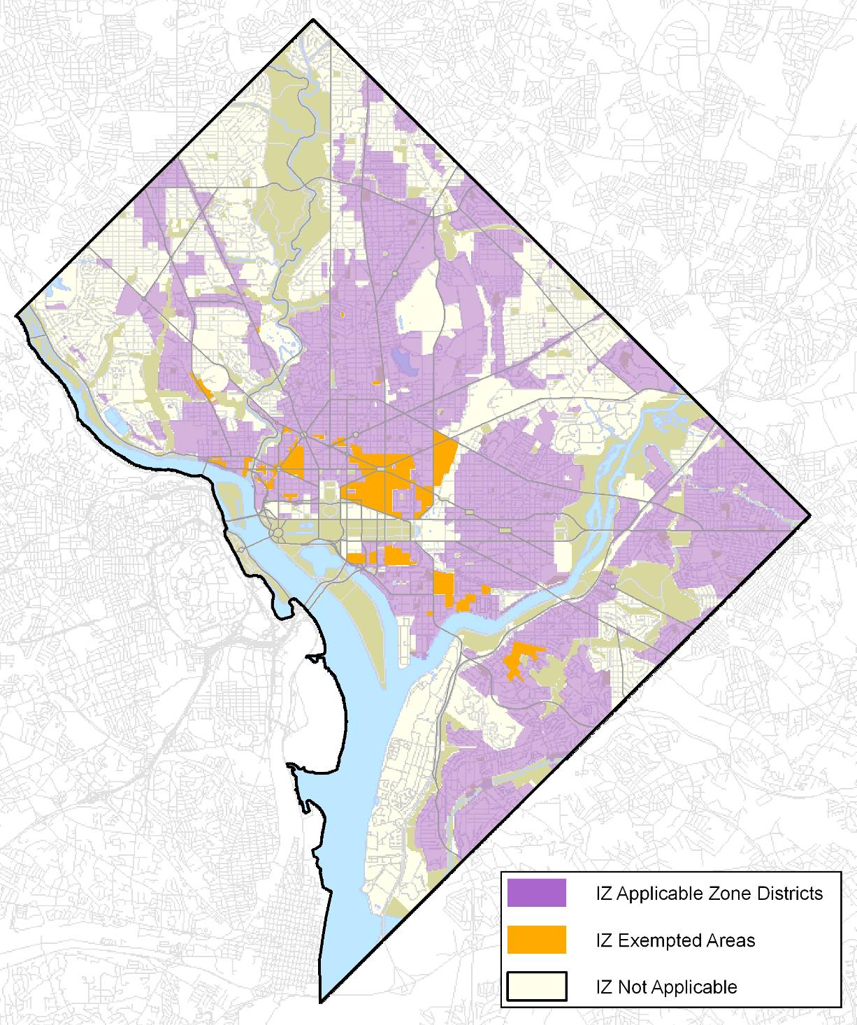
Applicability
New Construction of 10 units or more in most zones
Source: DC Office of Planning

Slide 11
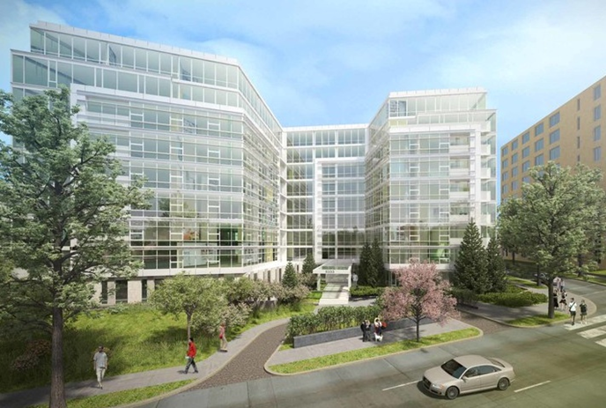
Affordability Set-Aside
Low Density Zones – 10% set aside between 50% MFI & 80% MFI
Higher Density Zones - 8% set aside, all at 80% MFI
20% density bonus to offset cost
Under construction: 5333 Connecticut Ave. NW in affluent Chevy Chase by Cafritz. 19 IZ units: 10 at 50% AMI, 9 at 80% AMI, Source: http://5333connave.com/
Notes:
or 50% to 75% of the bonus density achieved depending on zoning and construction type

Slide 12
Results to date
IZ units produced: 767
Low income vs. moderate affordability: 12% vs. 88% of IZ units
Rental vs. Ownership: 81% vs. 19%
In the pipeline: 1,124
IZ units as % where IZ applies: 10
Sources: DHCD as of 10/13/15 for production & income level; DHCD 2013 Inclusionary Zoning Annual Report for pipeline & applicability
Notes:
Source: DHCD as of 2/26/2015 & 2013 Annual report – Update with new numbers from Chris Marshall – 10-16-2015

Slide 13
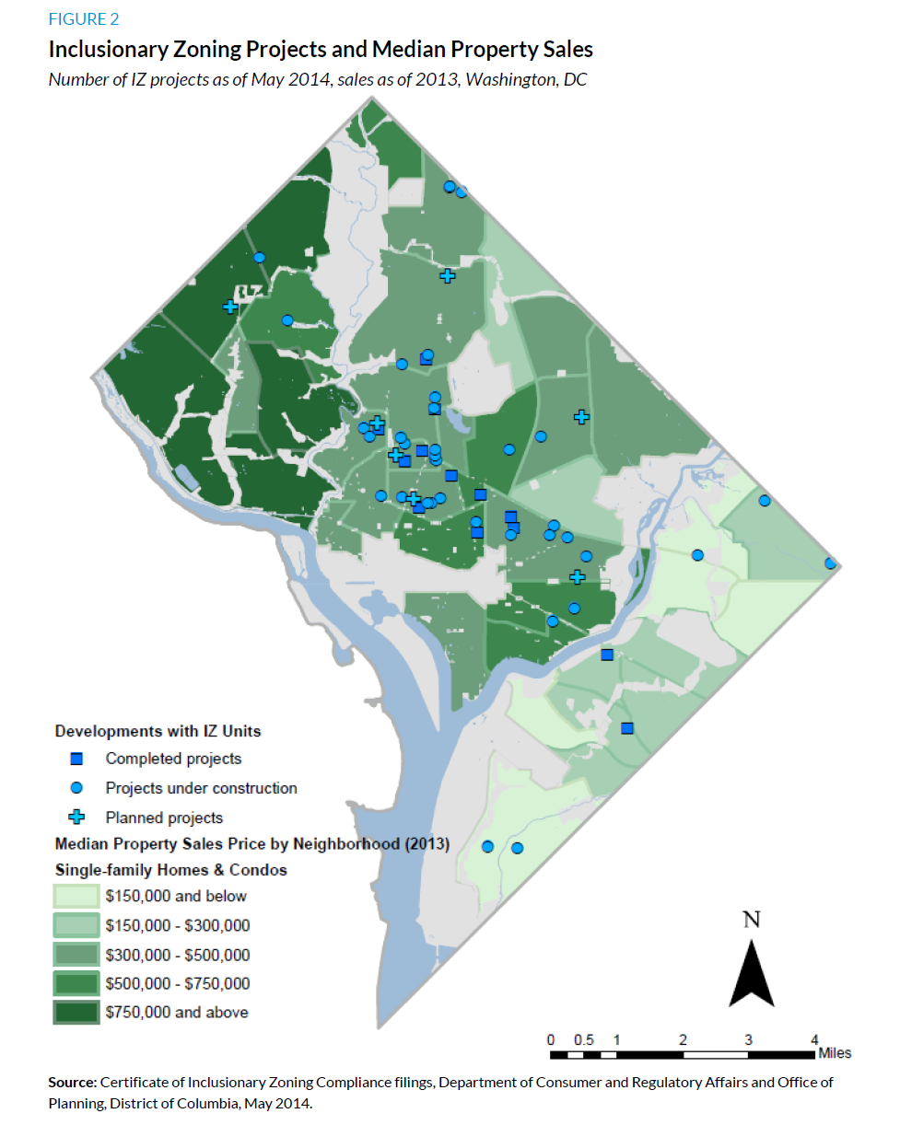
Results & status
Geographic distribution benefits from access to transit, jobs, opportunities
Administrative issues being addressed
Program acceptance: DC BIA opposition muted; support from developers & realtors
Zoning Commission, DC Council & Mayor Bowser support improving IZ
From: Urban Institute Affordable Housing Needs Assessment: Phase 1, 2014
Notes:
Urban Institute Affordable Housing Needs Assessment: Phase 1
http://www.urban.org/publications/2000017.html

Slide 14
Proposed changes: income targeting by OP
OP Recommendation 1 – change income targeting
Option 1B: split income requirements by tenure with 60% MFI for rental; 80% MFI for ownership
Our position: Option 1B maximizes low income housing production
  Rental & ownership split similar to our proposal
  81% of all IZ units have been rental
  Applying to current IZ numbers would yield 612 IZ units at 60% MFI vs. today’s 143 at 50 MFI
OP Option 1A: add more zones into 50%/80% MFI split requirements
Our position: Does not maximize low income housing production
Result would be 35% low income & 65% at 80% MFI

Slide 15
Other proposals by OP
OP: Off-site IZ units allowed within ½ mile with 20% more square footage as matter of right. Our position: Support but ask for 50% more
  OP: Allow requirement for 80% MFI for-sale units to be fulfilled with lesser number of 60% MFI for-sale units
  Our position: Support to accommodate weaker ownership markets
OP: Allow units with unaffordable condo fees flexibility in sales.
Our position: Support
OP: Expand Mayor’s right to purchase any amount of IZ units.
Our position: Support but call on Zoning Commission to support non-profit purchase & rental of IZ units

Slide 16
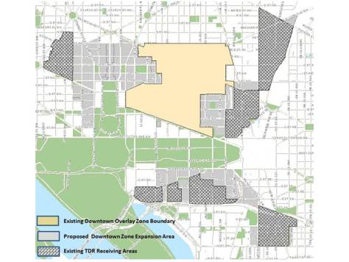
Other proposals by CIZ
Our proposal: Phase out exemption for Downtown Development District
Reinforce need for increased bonus density to compensate for deeper affordability & increased set aside, especially when revising Comprehensive Plan
Downtown Development District is exempt from IZ, but expansion areas (which are subject to IZ. Source: DC Office of Planning

Slide 17
Next steps
Zoning Commission Hearing on IZ
November 19, 6:30 pm – 9 pm
Message:
60% MFI for all rentals to maximize affordability
Highlight strengths & potential of IZ
Praise permanent affordability
If you can’t make the hearing, you can submit your testimony by email to zcsubmissions@dc.gov
Testimony prep assistance sessions

Slide 18
Contacts
Cheryl Cort, Coalition for Smarter Growth
cheryl@smartergrowth.net
202-251-7516
Claire Zippel, DC Fiscal Policy Institute
czippel@dcfpi.org
202-325-8351

